Slide 1

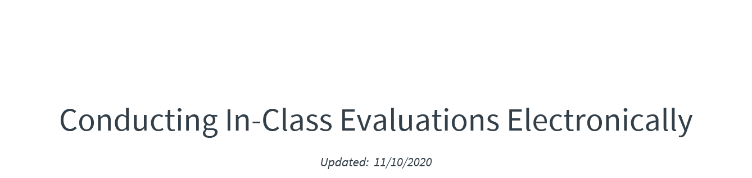
Notes:
Questions? Contact the CIS Coordinator: Nick Hinojosa (nick.hinojosa@austin.utexas.edu)

Slide 2

Notes:
Questions? Contact the CIS Coordinator: Nick Hinojosa (nick.hinojosa@austin.utexas.edu)

Slide 3
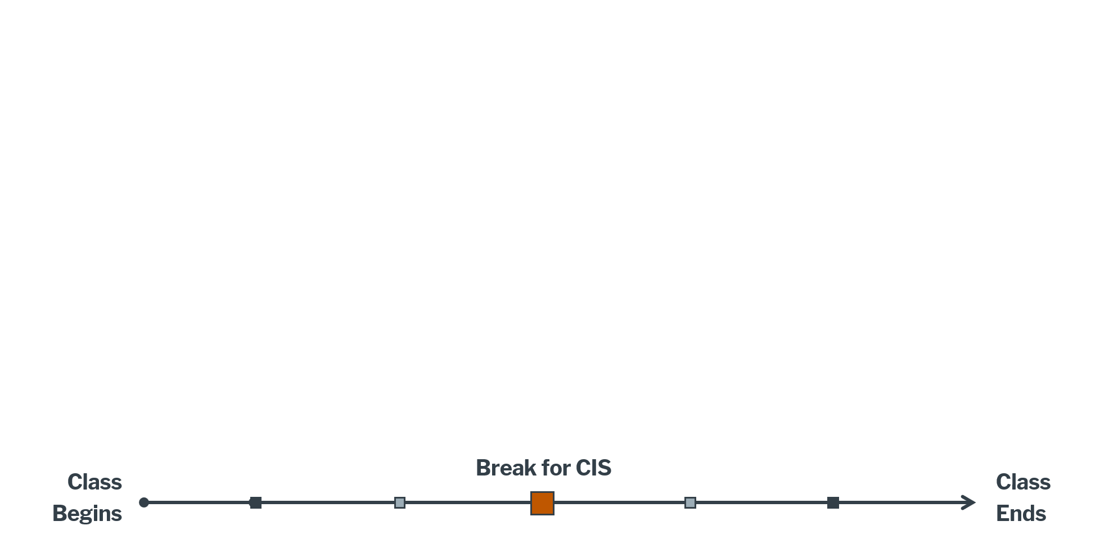
Notes:
***CAUTION – THESE SLIDES ARE NOT INTENDED TO BE PRESENTED. THEY SHOULD ONLY BE USED FOR YOUR PERSONAL REFERENCE.***

Slide 4

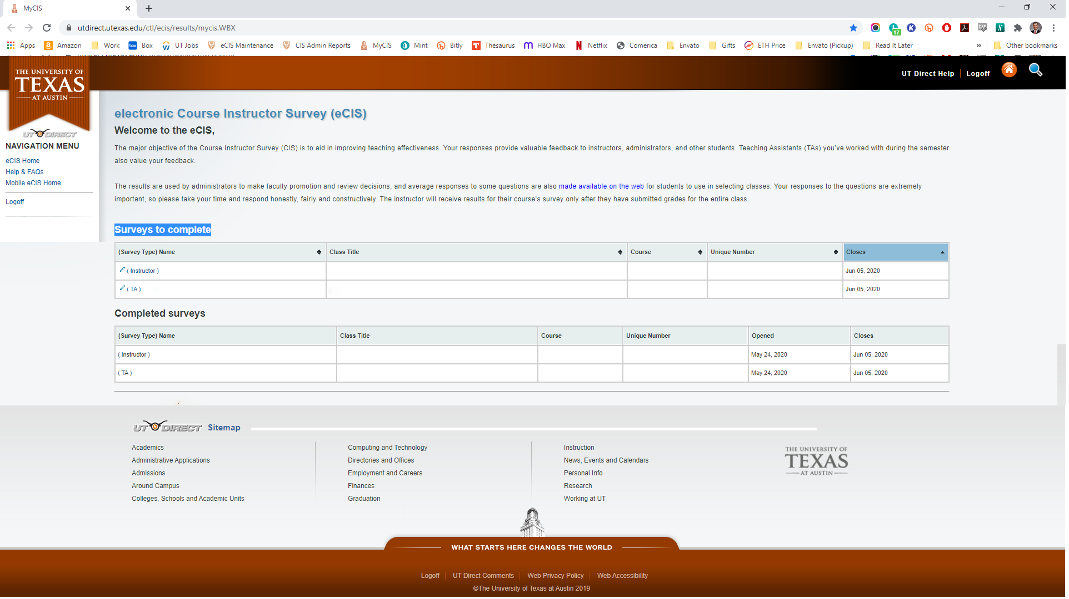
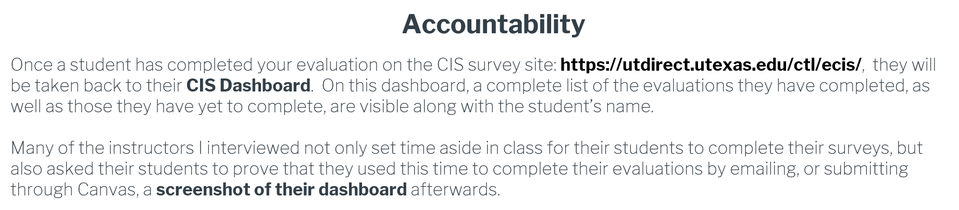
You can verify your student’s name here to determine if this screenshot is original.
Nick Hinojosa!
Once a student has completed your CIS, your course should appear on this table
Notes:
***CAUTION – THESE SLIDES ARE NOT INTENDED TO BE PRESENTED. THEY SHOULD ONLY BE USED FOR YOUR PERSONAL REFERENCE.***

Slide 5
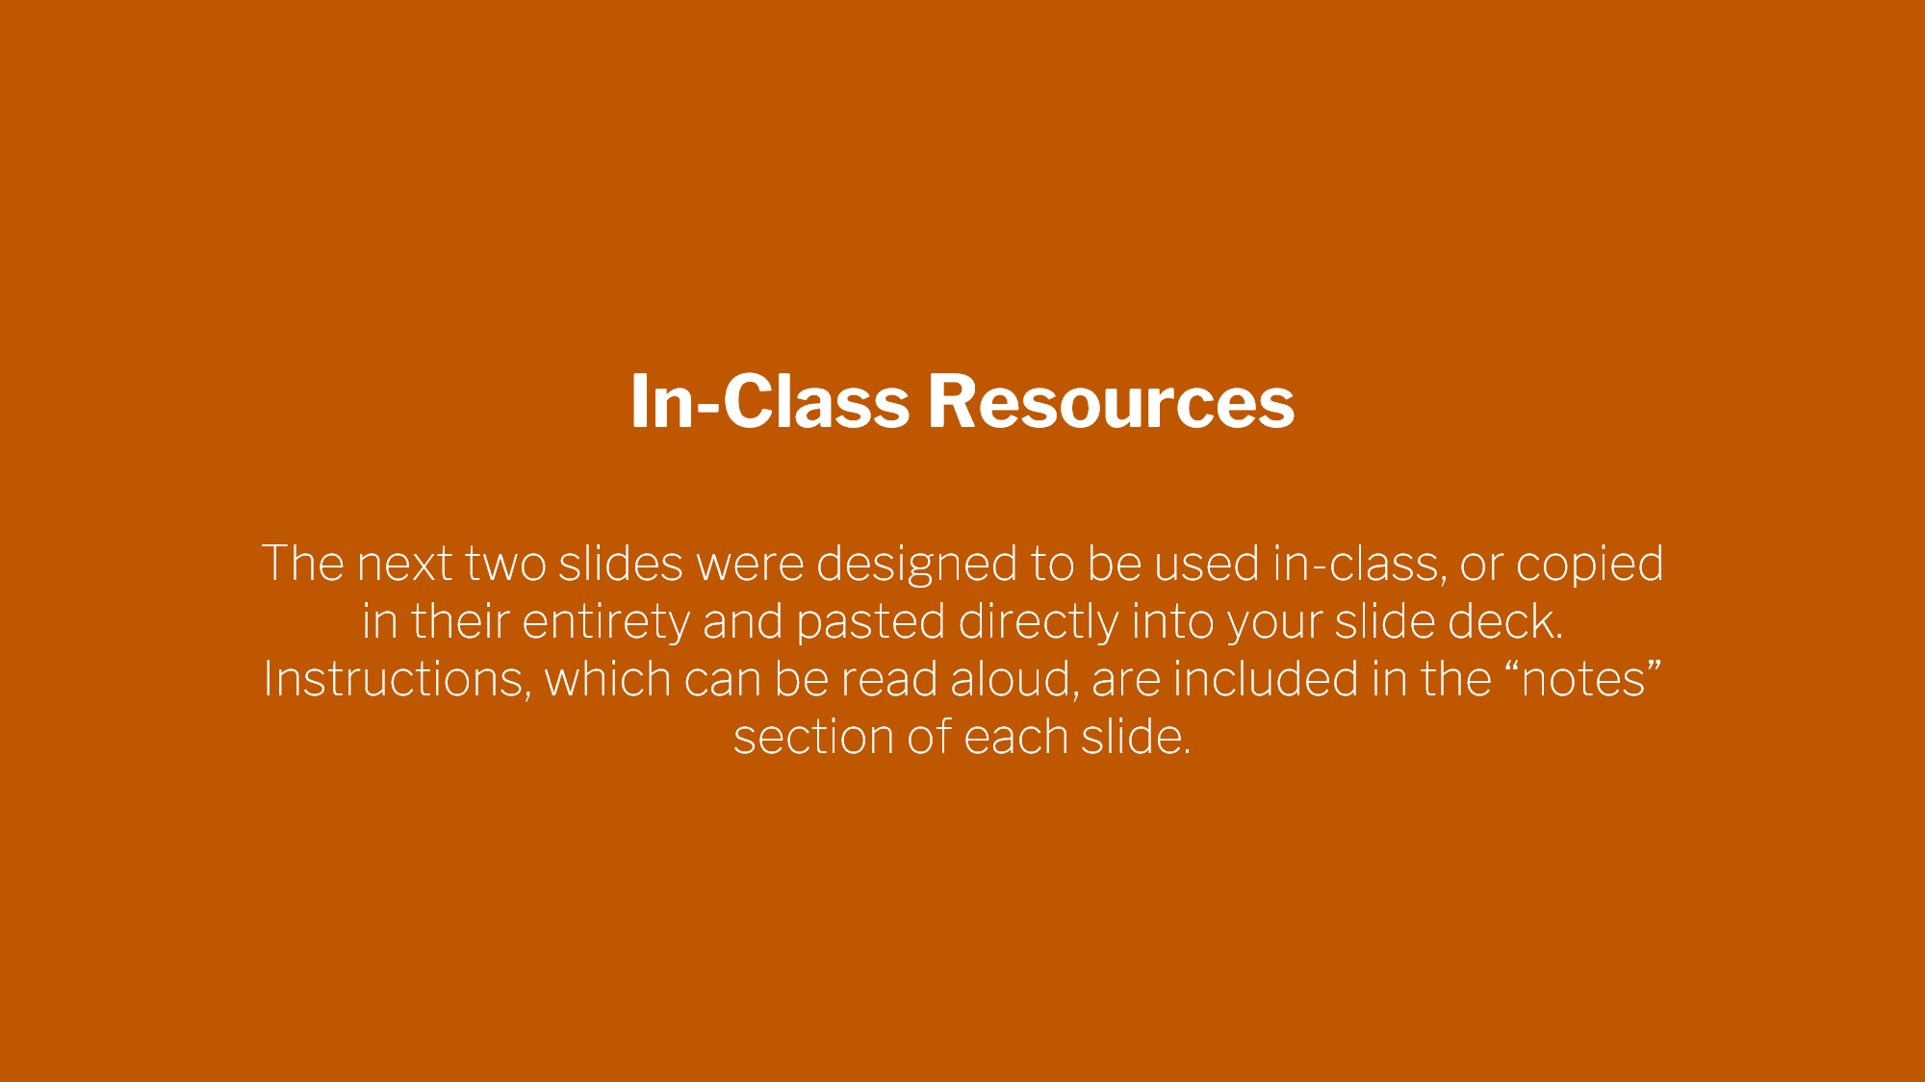
Notes:
Questions? Contact the CIS Coordinator: Nick Hinojosa (nick.hinojosa@austin.utexas.edu)

Slide 6
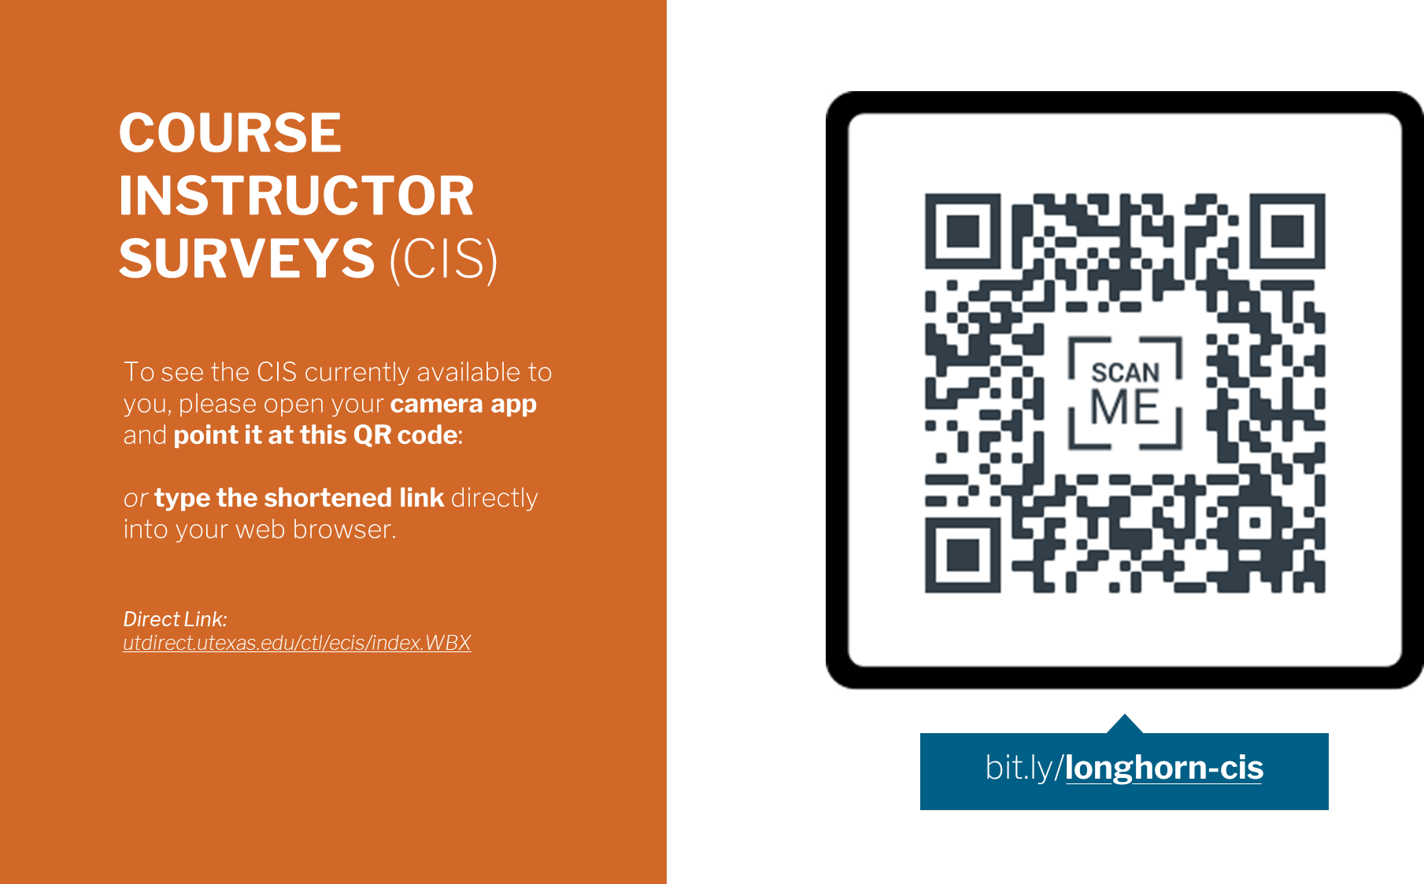

Notes:
READ ALOUD: During these next 15 minutes, I am going to ask you to complete an evaluation for this course. Please begin first by following scanning this QR code, typing in the shortened link, or if those don’t work, following this direct link (https://utdirect.utexas.edu/ctl/ecis/) to find your CIS homepage. [ADVANCE TO NEXT SLIDE]

Slide 7

Your Instructor will return at
00:00AM
Student Name!
Before then, please be sure to do the following:
Evaluate this course, any/all instructor(s), and any TA(s)
Take a screen-shot of this (Right) screen showing completion.
Mac: Shift + Command + 3
PC: CTRL + PRNTSCRN > CTRL + V, or via “Snipping Tool”
Send this screenshot to: instructoremail@utexas.edu
Instructor Last, Instructor First
COURST TITLE (AS IT APPEARS W/ REGISTRAR)
ABC 123L
#####
TA Last Name, TA First Name
COURST TITLE (AS IT APPEARS W/ REGISTRAR)
ABC 123L
#####
Hinojosa, Nicholas G
INTRO TO COUSE INSTRUCTOR SURV
CIS 411
#####
Rodriguez, Santos
INTRO TO COUSE INSTRUCTOR SURV
CIS 411
#####
Notes:
READ ALOUD: Your screen should now appear similarly to the one above. Please select my name from the table to ensure that you have access to my survey. If you do not see my name, the name(s) of any of your TA’s, or if the link does not appear to work at all, please send me an email immediately with your name, EID, and the Unique ID for this course.
*Explain in your own words* that you are not allowed to be present within the room while they complete this evaluation, or if this class is being conducted online, explain that you must mute your microphone and turn off your camera while they complete the evaluation. Let them know exactly what time you will return, identify your student volunteer, and ask that volunteer to read the instructions on the next slide.
[ADVANCE TO NEXT SLIDE]

Slide 8

Notes:
Questions? Contact the CIS Coordinator: Nick Hinojosa (nick.hinojosa@austin.utexas.edu)

Slide 9

Alternative Widescreen Slide Formats (16:9)
To change your slide deck to fit this format, simply visit the “Design” tab at the top your deck and select “Slide Size” on the right-hand side of the ribbon. Choose “Widescreen Slide (16:9)”.
OR
If you are more comfortable using the “Standard (4:3)” aspect ratio, we have created several graphics that fit that design much better further down the deck (Slides #-#).
Notes:
Questions? Contact the CIS Coordinator: Nick Hinojosa (nick.hinojosa@austin.utexas.edu)

Slide 10

The University of Texas at Austin
Department Name
Name of School or College Name
Notes:
READ ALOUD: During these next 15 minutes, I am going to ask you to complete an evaluation for this course. Please begin first by following scanning this QR code, typing in the shortened link, or if those don’t work, following this direct link (https://utdirect.utexas.edu/ctl/ecis/) to find your CIS homepage. [ADVANCE TO NEXT SLIDE]

Slide 11
The University of Texas at Austin
Biomedical Engineering
Cockrell School of Engineering
Notes:
READ ALOUD: During these next 15 minutes, I am going to ask you to complete an evaluation for this course. Please begin first by following scanning this QR code, typing in the shortened link, or if those don’t work, following this direct link (https://utdirect.utexas.edu/ctl/ecis/) to find your CIS homepage. [ADVANCE TO NEXT SLIDE]

Slide 12

Notes:
READ ALOUD: During these next 15 minutes, I am going to ask you to complete an evaluation for this course. Please begin first by following scanning this QR code, typing in the shortened link, or if those don’t work, following this direct link (https://utdirect.utexas.edu/ctl/ecis/) to find your CIS homepage. [ADVANCE TO NEXT SLIDE]

Slide 13
Standard Slide (4:3)
If you normally use the box-like slide format (ie: The Standard Slide with a 4:3 aspect ratio), this graphic will probably fit your slide deck better.
Simply right-click, cut and paste into your deck.
The University of Texas at Austin
Department Name
Name of School or College Name
Notes:
READ ALOUD: During these next 15 minutes, I am going to ask you to complete an evaluation for this course. Please begin first by following scanning this QR code, typing in the shortened link, or if those don’t work, following this direct link (https://utdirect.utexas.edu/ctl/ecis/) to find your CIS homepage. [ADVANCE TO NEXT SLIDE]

Slide 14

Notes:
Questions? Contact the CIS Coordinator: Nick Hinojosa (nick.hinojosa@austin.utexas.edu)

